Slide 1
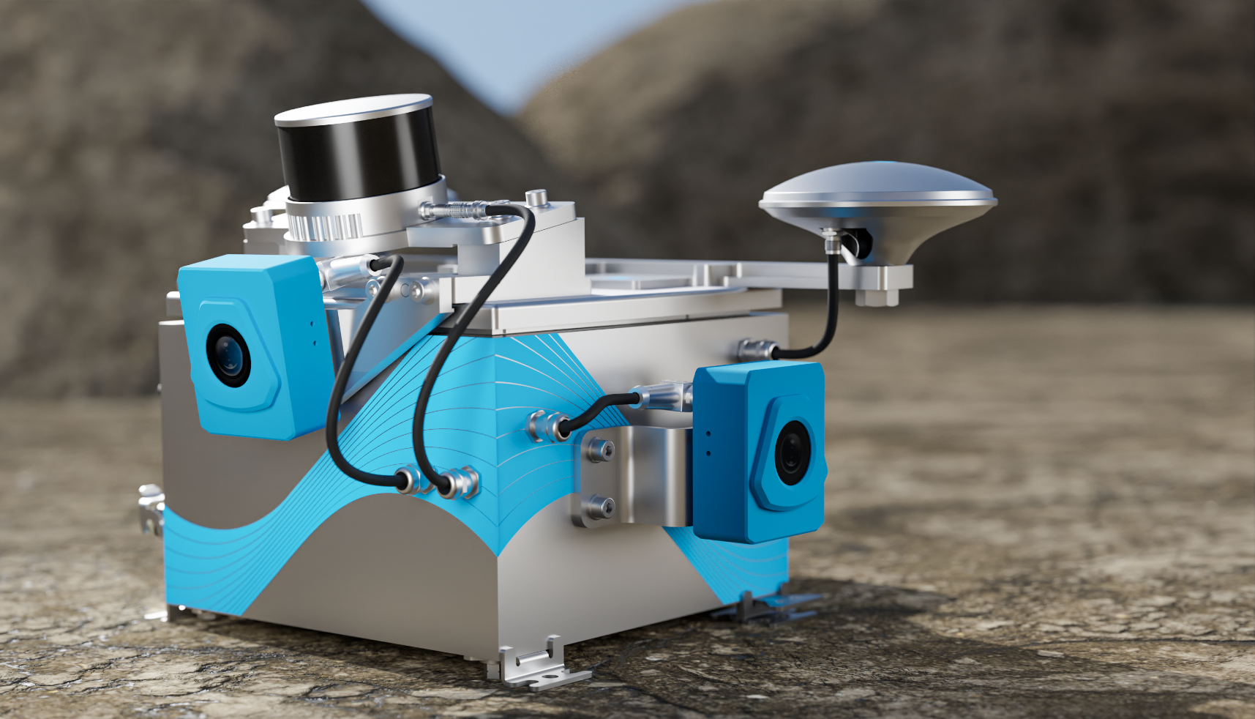

Jobsite Technologies, Inc
New Product Launch

Slide 2
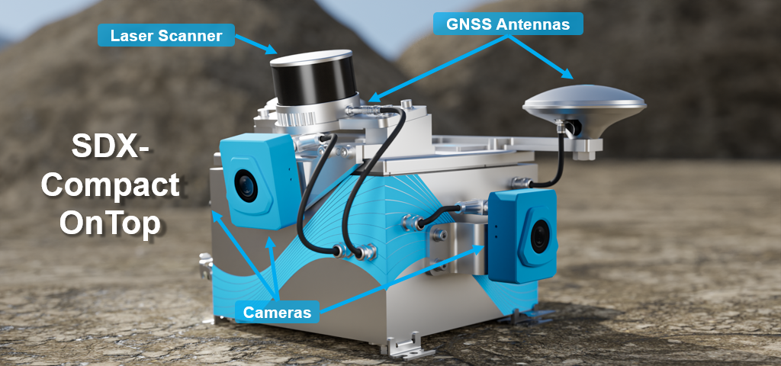
A comprehensive system with all sensors and processing capabilities built-in, resulting in no calibration necessary

Slide 3
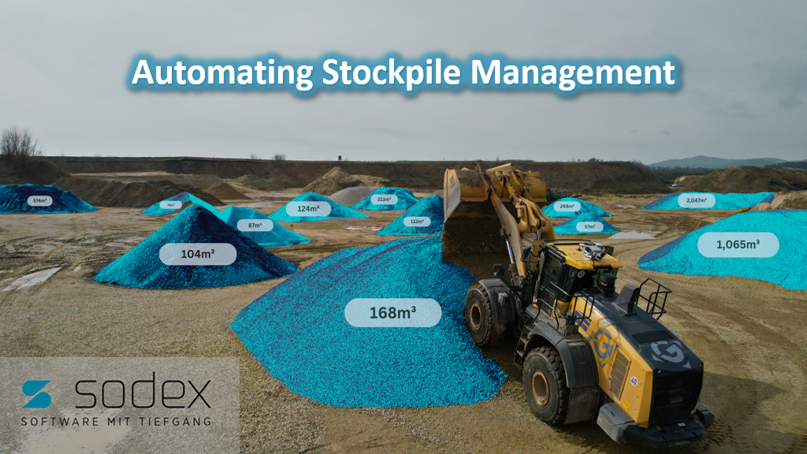

Slide 4
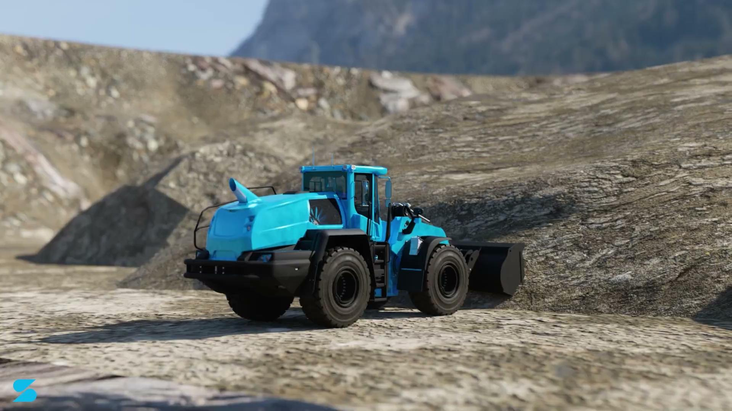

Slide 5
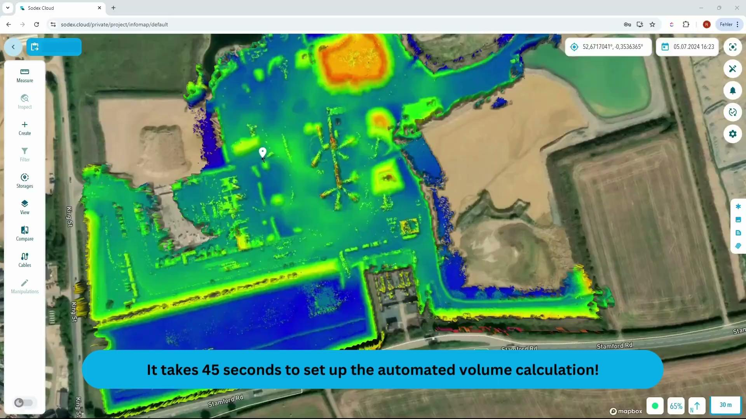
Define and save material storage areas to profit from automated inventory assessments

Slide 6
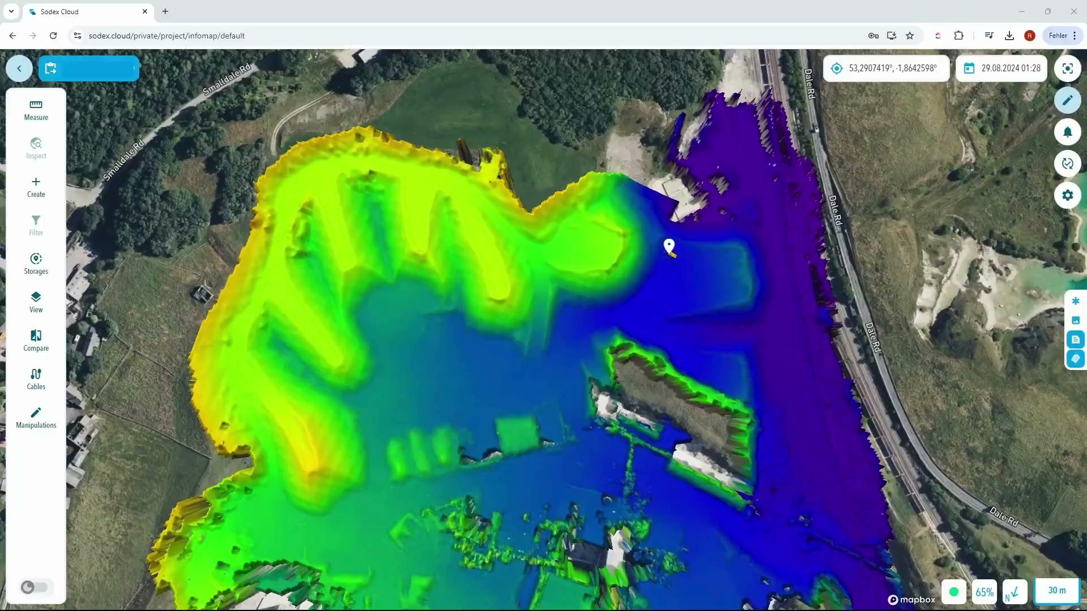
Get a quick overview of stock levels and historical trends without any manual work

Slide 7
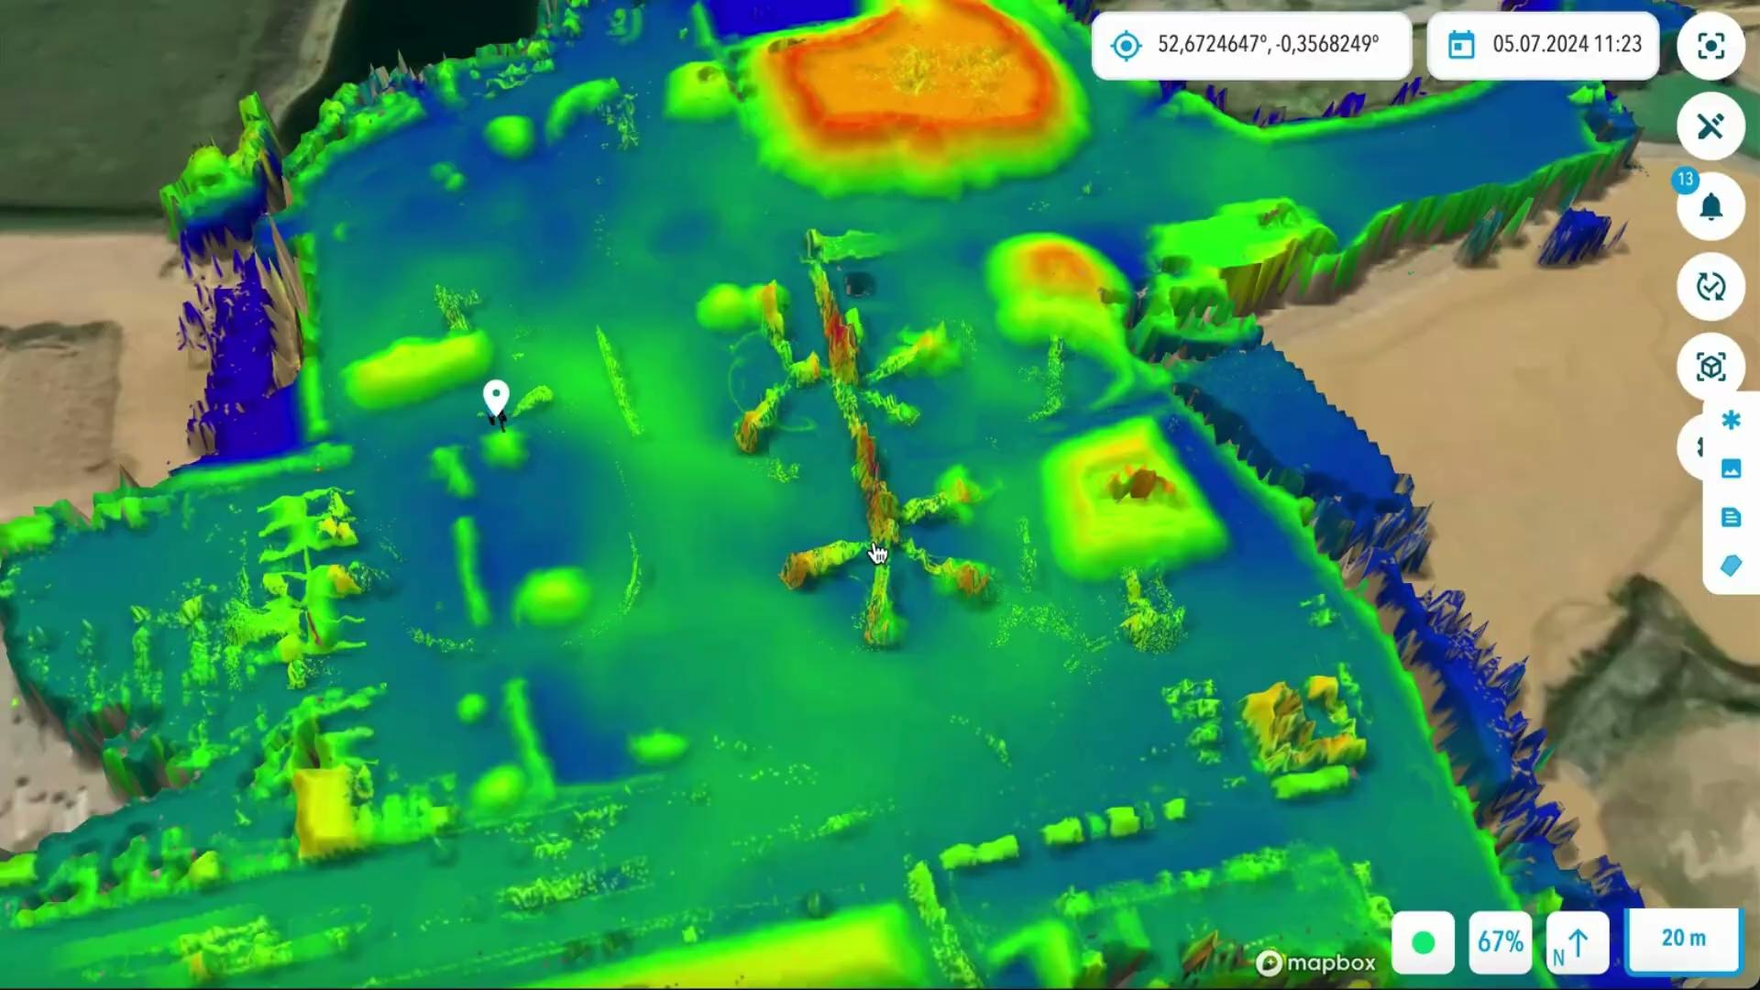
Get a quick overview of stock levels and historical trends without any manual work

Slide 8
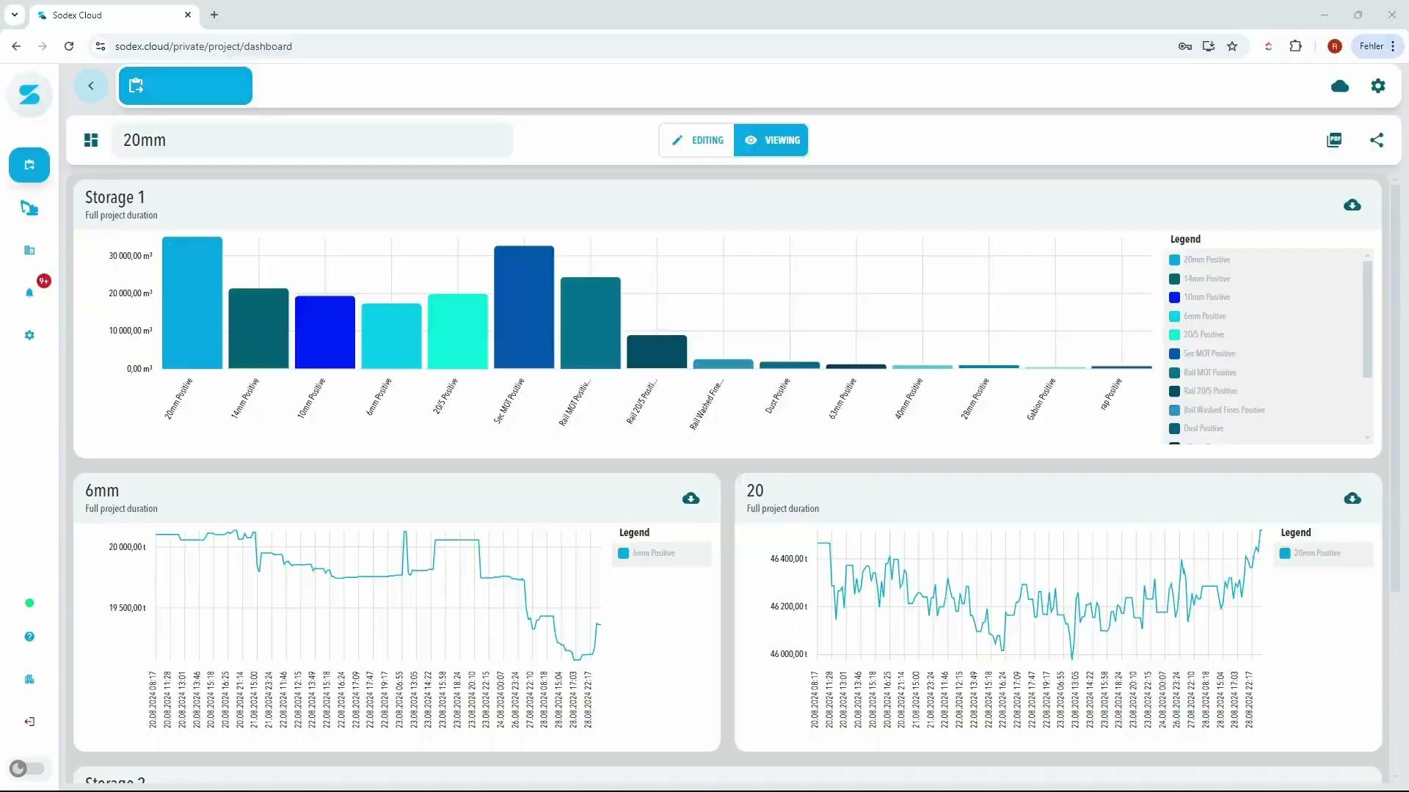
Build informative dashboards and share them with key stakeholders

Slide 9

Inventory monitoring made effortless!
<1%
20min
100%
Error Compared to Actual Stockpile Volume
Frequency of data updates
Compatible with your existing workflows

